Slide 1
Graphene-Graphite Aluminum Battery (or is it a Capacitor)
Bartholomew T. Frey
Stark County High School
Toulon, IL

Slide 2
Problems with Traditional Batteries
Society moves from dependence on fossil fuels, and moves towards greener forms of energy.
Demand for batteries is increasing at an enormous rate.
Commercially manufactured contain materials that are detrimental to the environment, explosive, made from expensive materials, and/or present a difficulty for disposal.

Slide 3
Why Use Aluminum, Graphene, & Graphite?
Constructing a battery from cheap materials that are readily available, recyclable, and are less harmful to the environment is a desired.
Won’t explode or catch fire.
Aluminum is the third most abundant material in the Earth’s crust and is exceptionally recyclable.
Carbon, the only element in graphene and graphite, is the fourth most abundant element in the universe and also positively addresses the concerns of current battery materials.

Slide 4
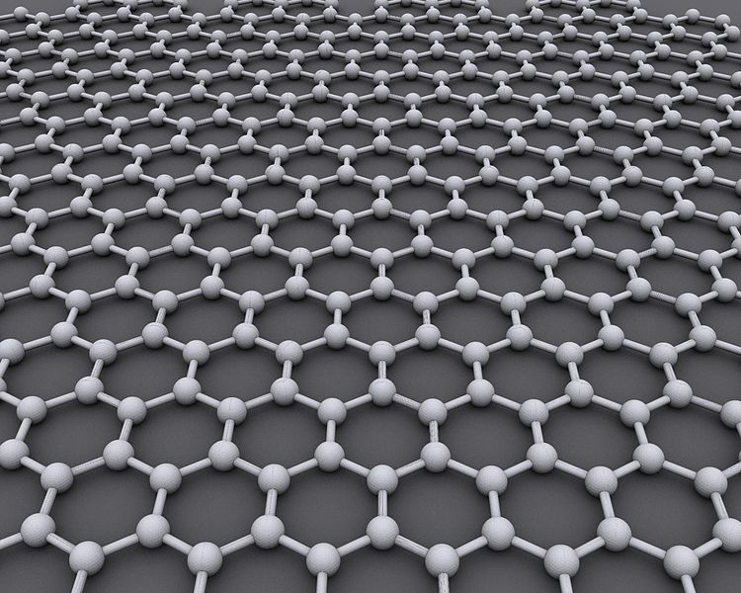
WHAT ARE GRAPHENE AND GRAPHITE?
Graphene is a single layer of hexagonal carbon
Semiconductor
Lower resistivity than silver
High electron mobility
2D material, so it is bendable
Graphite
Semiconductor
Multiple layers of Graphene
Weak van der Waals Forces allows it to be separated in layers
Thermally stable
https://en.wikipedia.org/wiki/File:Graphen.jpg

Slide 5
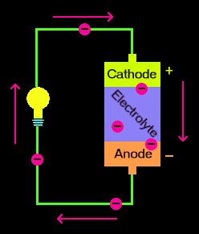
Typical Battery Design
A battery consists of three parts:
Cathode (positively charged)
Anode (negatively charged)
Electrolyte- allows the transfer of charge
A battery stores chemical energy
When a battery is connected to a circuit, electrons move from the anode to the cathode, providing electrical energy.
http://www.qrg.northwestern.edu/projects/vss/docs/media/Power/battery.gif

Slide 6
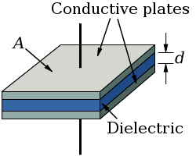
Typical Capacitor design
Two conductive plates with a dielectric (insulator) between the plates
Stores energy in an electrical field
Must be charged with a power source
https://upload.wikimedia.org/wikipedia/commons/3/35/Parallel_plate_capacitor.svgto add text

Slide 7
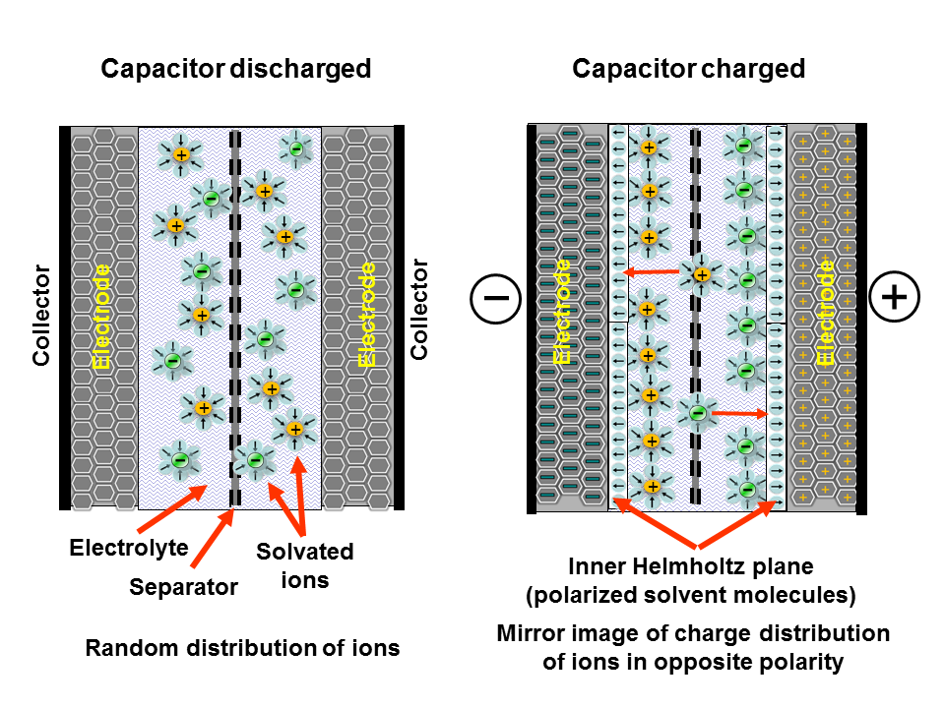
Carbon based Dual Layer supercapacitors
Collector made from metal foil (outside layer)
Activated carbon, graphene, carbon nanotubes, or carbon aerogel as electrodes (connected or bonded to collector)
Wet electrolyte between double layer electrodes
Separator- ion permeable membrane in electrolyte
By Elcap - Own work, CC0, https://commons.wikimedia.org/w/index.php?curid=25527585

Slide 8
Capacitance of Thin materials
The capacitance of atomically thin graphene consists of EDL capacitance (C_{EDL}) and quantum capacitance (C_{Q}) in series, so that the total capacitance (C_{T}) becomes:
1/C_{T} = 1/C_{EDL} + 1C_{Q}.
References:
https://www.nature.com/articles/nnano.2009.177
https://www.nature.com/articles/ncomms4317

Slide 9
Financial support was provided by the National Science Foundation under grant #NSF EEC 14-07194 RET, as part of the nano@illinois project, through the University of Illinois Center for Nanoscale Science and Technology and the Micro and Nanotechnology Lab at the University of Illinois at Urbana-Champaign.
This work, which includes teacher and student resources, is licensed under a Creative Commons Attribution-Noncommercial-Share Alike 3.0 Unported License. To view a copy of this license, visit: http://creativecommons.org/licenses/by-nc-sa/3.0/. To attribute this work, please use [“B. Frey. Graphene-Graphite Aluminum Battery (or is it a Capacitor) Presentation (2018).”]
The nano@illinois Research Experience for Teachers (RET) at the University of Illinois at Urbana-Champaign (from 2014-2017) exposes a diverse set of in-service and pre-service science, technology, engineering, and mathematics (STEM) teachers and community college faculty from across the nation to cutting-edge research in nanotechnology. The RET focuses on recruiting underrepresented minority populations (focused on ethnicity, geography, disability, and veteran status) including women and will target teachers from high-need areas, including inner city, rural, low-income, and those with significant URM students. Participants conduct research over 6 weeks in world-class labs with 4 follow-up sessions during the school year.
Teacher professional development opportunities includes teacher-focused lectures, mentoring, networking, poster sessions, ethics seminars, hands-on modules, STEM education issues, career choices, and resources for implementing a nano lab and curriculum. Teachers will develop modules to be disseminated widely and present their results. High-quality follow-up sessions and evaluation will be infused.
The nano@illinois Research Experiences for Teachers (RET) is managed by the University of Illinois Center for Nanoscale Science Technology.
Center for Nanoscale Science and Technology
208 N. Wright, MC-249
Urbana, Illinois 61801
217-244-1353
nanotechnology@illinois.edu
www.nano.illinois.edu

